Slide 1
MATHEMATICS FOR COMPETITIVE CONTINUED
Sanyam Garg

Slide 2

Solving Linear Recurrence using matrix exponentiation
https://codeforces.com/contest/1182/problem/E

Slide 3

Pigeonhole Principle
Divisible Subset or Subsegment Question :
What is the difference between a Subset and a Subsegement?

Slide 4
Pigeonhole Principle Problem
https://www.codechef.com/problems/GRAYSC
https://www.spoj.com/problems/HOLI/

Slide 5
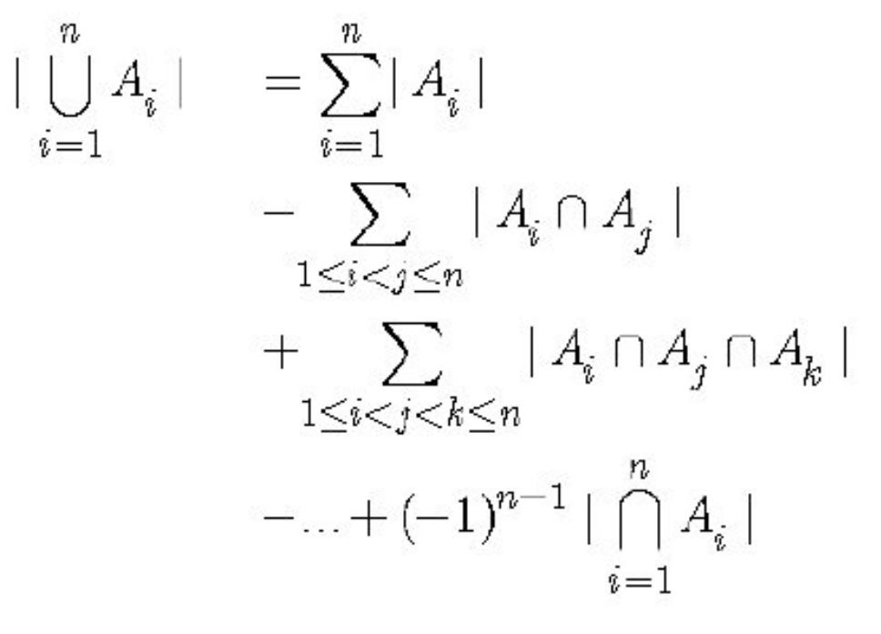
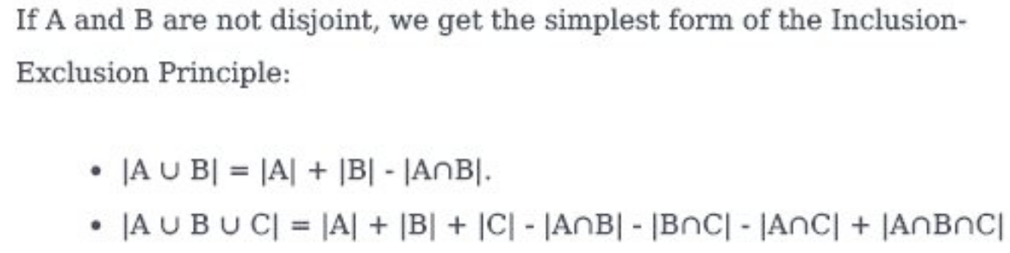
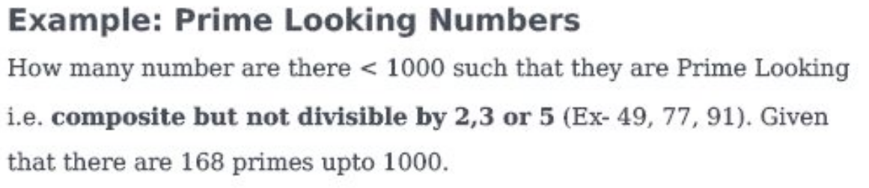
Inclusion-Exclusion Principle

Slide 6
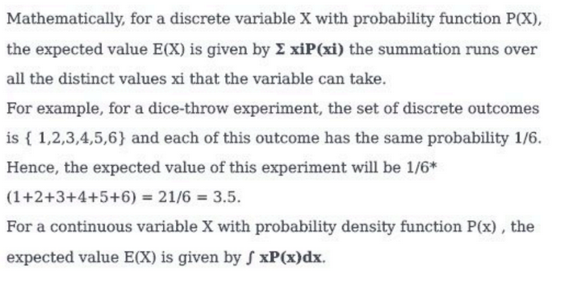
Expectation

Slide 7
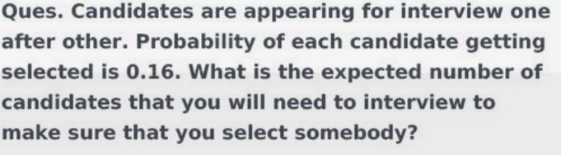
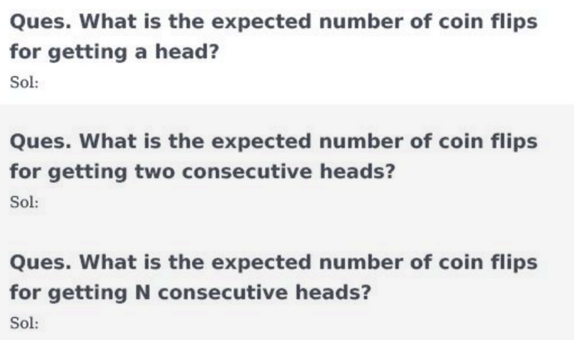
Expectation Problems

Slide 8
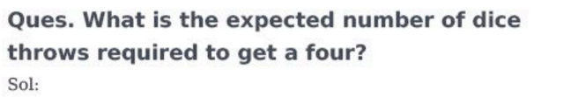
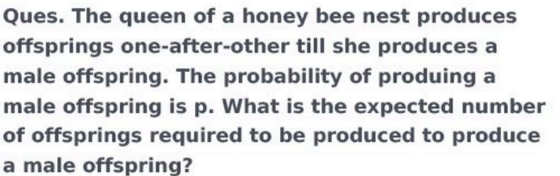
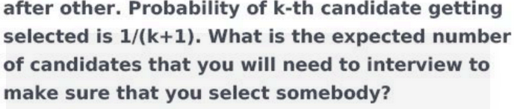
Expectation Problems

Slide 9
Linearity of Expectation
E(aA + bB) = aE(A) + bE(B)

Slide 10
Coupon Collector Problem
Y(i) = Number of coupons till the new coupon
X(i) = Y(i) - Y(i-1)
X0 = Y1 - Y0 = 1, …...

Slide 11
Sieve of Eratos

Slide 12
Last Problem :
https://www.codechef.com/JAN15/problems/SEALCM

